Slide 1

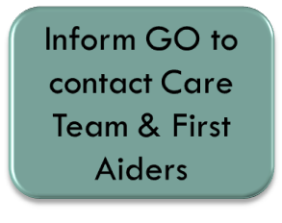




Safety Procedure Flowchart
Useful Contact Information
Principal: 98415273
VP1: 98265810
VP2: 93636393
Care Member:
First Aider:
Ambulance:
CCK Polyclinic:
*CAT 3 – Minor Injury
CAT 2 – Major Injury
CAT 1 – Serve Injury
CAT 3*
Yes
No

